Slide 1

Submitted By;
Group-9
Nahian Ma Jabin (2023-3-60-045) Jannatul Ferdous Bristy (2023-3-60-344)
Nur Mohammad Junayed (2023-3-60-596)
CSE 106
DISCRETE MATH
SECTION- 4
Submitted to
Dr. Md Mozammel Huq Azad Khan
Professor
Department of Computer Science and Engineering

Slide 2
Submitted By;
Group-9
Nahian Ma Jabin (2023-3-60-045) Jannatul Ferdous Bristy (2023-3-60-344)
Nur Mohammad Junayed (2023-3-60-596)
CSE 106
DISCRETE MATH
Submitted to
Dr. Md Mozammel Huq Azad Khan
Professor
Department of Computer Science and Engineering
SECTION- 4

Slide 3

INTRODUCTION
Using C program , randomly generate an directed graph represented by adjacency matrix with n =1000 vertices .
Determine number of edges in the graph .Determine degree of all vertices . Show that sum of in-degrees and sum of out-degrees are equal . Determine computational time in this step (except printing time ) in ms .

Slide 4

Source Code
#include <iostream>
#include <chrono>
using namespace std;
#define time_now chrono::high_resolution_clock::now()
const int vertices = 5000;
int directed_graph[vertices][vertices]={};
int main(){
auto start = time_now;
int x=3, a=0 , sum_of_out_degree=0, sum_of_in_degree=0;
for(int i=0; i<vertices; i++){
for(int j=0; j<vertices; j++){
a = ((7*x)+4)%9;

Slide 5
Source Code
x=a;
directed_graph[i][j] += a%2;
}
}
for(int i=0; i<vertices; i++){
for(int j=0; j<vertices; j++){
if(directed_graph[i][j]){
sum_of_out_degree++;
}
if(directed_graph[j][i]){
sum_of_in_degree++;
}
}
}

Slide 6
Source Code
cout << "Number of vertices: " << vertices << "\n";
cout << "Sum of in degrees: " << sum_of_in_degree << "\n";
cout << "Sum of out degrees: " << sum_of_out_degree << "\n";
if(sum_of_in_degree == sum_of_out_degree){
cout << "Sum of in-degrees and Sum of out-degrees are equal" << "\n";
}
auto end = time_now;
auto difference = chrono::duration <double, milli> (end-start).count();
cout << "Time Taken: " << difference << "ms" << "\n";
return 0;
}

Slide 7

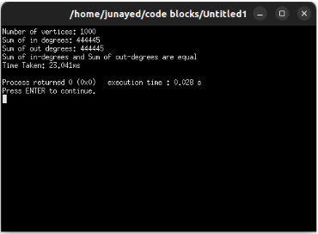
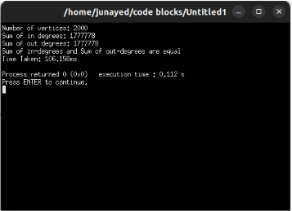
N=1000
OUTPUT
N=2000

Slide 8
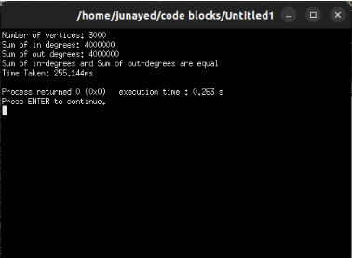
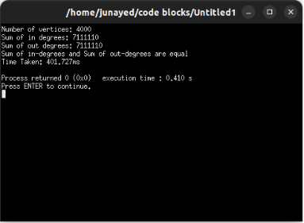
N=3000
OUTPUT
N=4000

Slide 9
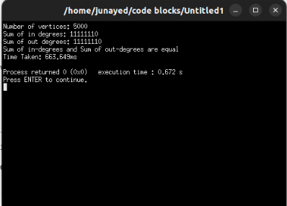
N=5000
OUTPUT

Slide 10

The Equality of the Sum of In-degrees and out-degrees
Number of vartices (n) | Number of in-degrees | Number of out-degrees
1000 | 444445 | 444445
2000 | 1777778 | 1777778
3000 | 4000000 | 4000000
4000 | 7111110 | 7111110
5000 | 1111110 | 1111110
The table shows the number of in-degrees and out-degrees when n=1000, 2000, 3000, 4000, 5000.
Hence, we can say that the sum of in-degrees and out-degrees are equal.

Slide 11
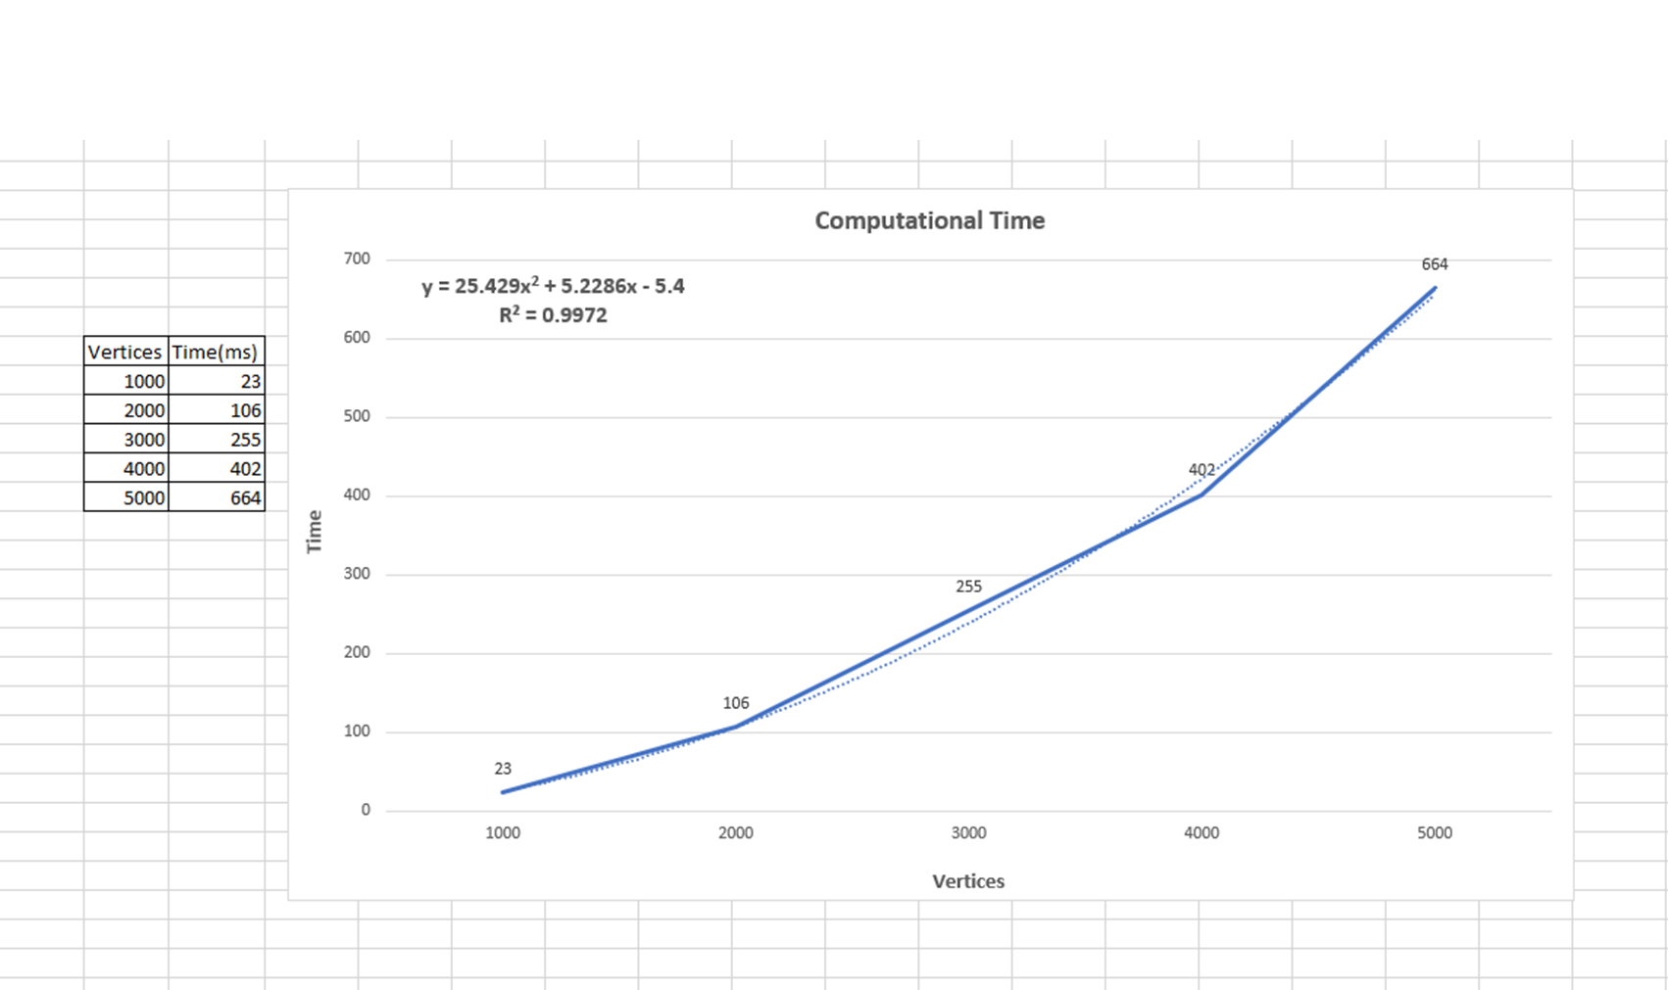
The Equality of the Sum of In-degrees and out-degrees
Number of vartices (n) | Number of in-degrees | Number of out-degrees
1000 | 444445 | 444445
2000 | 1777778 | 1777778
3000 | 4000000 | 4000000
4000 | 7111110 | 7111110
5000 | 1111110 | 1111110
The table shows the number of in-degrees and out-degrees when n=1000, 2000, 3000, 4000, 5000.
Hence, we can say that the sum of in-degrees and out-degrees are equal.

Slide 12

Derived Equation From the Graph
Equation:
25.429x^2 + 5.2286x - 5.4
g(n) = 25.429n^2 + 5.2286n - 5.4
Now, 25.429n^2 + 5.2286n - 5.4 <= 25.429n^2 + 5.2286n^2 - 5.4n^2 [n^2 >= n, n^2 >= 1]
--> 25.429n^2 + 5.2286n - 5.4 <= 25.2576n^2 [k = 1, c = 25.2576] g(n) = 25.429n^2 + 5.2286n - 5.4 = O(n^2)

Slide 13

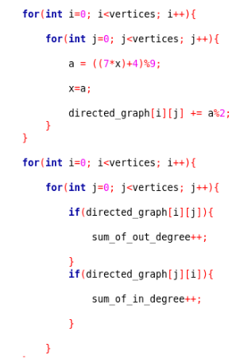
Time Complexity of Program
Here in the program we used two nested loops. In each nested loops the inner loop is running n times and one extra time for exiting the loop and like the inner loop the outer loop also runs n times and one extra comparison for exiting the loop. So the equation for each nested loops will be, (n*(n+1)) + 1.

Slide 14
Time Complexity of Program
The relation between graph time complexity and theoretical time complexity
Here in the program we used two nested loops. In each nested loops the inner loop is running n times and one extra time for exiting the loop and like the inner loop the outer loop also runs n times and one extra comparison for exiting the loop. So the equation for each nested loops will be, (n*(n+1)) + 1.
The time complexity from the graph is
g(n)= O(n²)
The time complexity obtained theoretically
f(n)= O(n²)
So the theoretical time complexity is same as the time complexity we got from the graph

Slide 15

THANK YOU

